Slide 1
Analysis of the air quality in New York City
By Jin Bae, Dheeraj Manon and Amandine Lemonnier

Slide 2
Table of content
Introduction
Method
Analysis
Limitations
Conclusion

Slide 3
Introduction
New York City Air quality data from 2005 to 2013
Data obtained from data.gov website in the .csv format.
Covers different cities across New York City
Data shows air quality values with different measures under consideration
Measure(type), GeoName(Neighborhood Name), GeoID, GeoEntityName(various cities), Year, Measure Value(Concentration Level)
USA Air Quality data from any years
Data provider looked at the entire United States -New York State was singled out through coding
Datasets looks at healthy days vs, unhealthy days vs, hazardous days, and more

Slide 4
Method
Data clean up
Few extra columns were deleted
Used fillna(0) to have a good dataframe for analysis
Data analysis
Used Pandas dataframe, Seaborn for graphs
File type: CSV
Particularly looking which neighbourhoods within NYC city have what types of air quality measures
Data graphing
Seaborn

Slide 5
Analysis - New York State Overview
Part 1: Selecting New York State Data only
County2006 = df2006['County']
NYCounty2006 = County2005[630:664]
print(NYCounty2005)
Part 2: Graphing for Moderate Days:
ax2006_2 = sns.barplot(x= NYCounty2006, y='Moderate Days', data=df2006)
ax2006_2.set_xticklabels(NYCounty2006,rotation=45)
plt.title("Number of Moderate Days per New York County for Year 2006")

Slide 6
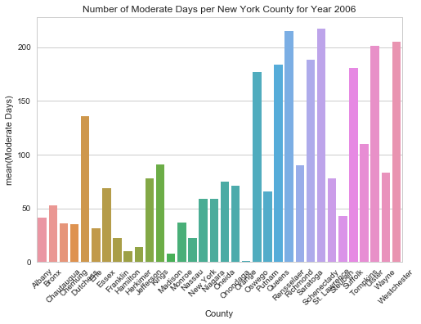
Analysis - New York State Overview

Slide 7
Analysis - New York State Overview
Part 1: Selecting New York State Data only
County2006 = df2006['County']
NYCounty2006 = County2005[630:664]
print(NYCounty2005)
Part 2: Graphing for Unhealthy Days:
ax2006 = sns.barplot(x= NYCounty2006, y='Unhealthy Days', data=df2006)
ax2006.set_xticklabels(NYCounty2006,rotation=50)
plt.title("Number of Unhealthy Days per New York County for Year 2006")

Slide 8
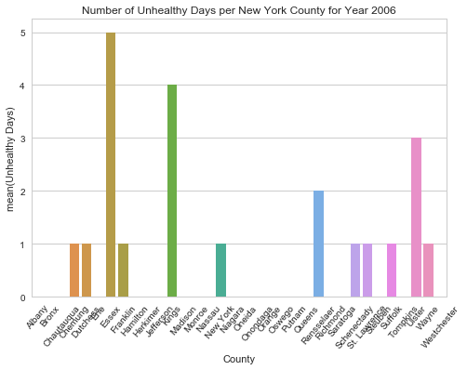
Analysis - New York State Overview

Slide 9
Analysis - New York State Overview
Governmental Data is available regarding air quality in New York States for each calendar years
Analysis has been made to look at the air quality of each year from 2005-2007 and 2009-2011
Analysis needs to be made in order to combine all analysez years
The goal is to see if there are changes in the number of days with poor air quality in the state
Air quality was defined as through as followed:
'Good Days'
'Moderate Days'
'Unhealthy for Sensitive Groups Days'
'Unhealthy Days'
'Very Unhealthy Days'
‘'Hazardous Days'
All data com from governmental sources

Slide 10
Analysis - Age Groups affected / Area affected
What age group are considered in the 2005-2007 and 2009-2011 data?
How many people in particular age group in particular years?
Analysis has made of not only in 2005-2007 but also of all years in the dataset.
What are the total and average of each columns ?
Analysis was focused on air quality measure values.
Which age group has highest average of measure values?
This includes the measurement in measure column.
Which area has highest average of measure values?
Area meant by the districts of NYC.

Slide 11
Analysis - Measures
What is the total count of different types of Measure for each GeoName for the year 2009-2011?
What is the average count with measure 40 yrs and older for years 2005-2007 and 2009-2011 ?
What is the measure value for measure Adult 30 yrs and older for the year 2009-2011 with GeoEntityName Bronx?

Slide 12
Limitations
Data from other specific cities were not found, a comparison would have allowed for more depth of analysis
The main dataset regarding New York city has gaps in years
Population count was missing
Factors such as the effect on the population are not recorded
Notes:
The data analyzed were not correctly collected, all data come from a governmental source. Additional data may be interesting to look at although they were not recorder

Slide 13
Additional Work and Future Work
Graphs have been created for all of the years necessary looking at the moderate days and unhealthy days.
Plans are to also look at hazardous days and unhealthy days for sensitive groups
A graph may be made looking at the overall unhealthy or moderate days compared to healthy days in the state
At the moment, I have not been able to properly format the data to sum the days.
If time permits, a graph looking at the overall data over the years will be made
The graph will look at the progression of the healthy and unhealthy days in New York State over the years used during the analysis

Slide 14
Conclusion

Slide 15
Resources
City of New York city, 2018. “Air quality” from: https://catalog.data.gov/dataset/air-quality-ef520
https://aqs.epa.gov/aqsweb/airdata/download_files.html

